Slide 1

Scanner Class for Data Input

Slide 2
Today’s Agenda
Scanner Class for Data Input in Java
Integer Data Input
String Data Input
Double Type Data
Array input
Array Searching

Slide 3
Java Scanner Class
Scanner class in Java is found in the java.util package. Java provides various ways to read input from the keyboard, the java.util.Scanner class is one of them.
The Java Scanner class breaks the input into tokens using a delimiter which is whitespace by default. It provides many methods to read and parse various primitive values.
The Java Scanner class provides nextXXX() methods to return the type of value such as nextInt(), nextByte(), nextShort(), next(), nextLine(), nextDouble(), nextFloat(), nextBoolean(), etc. To get a single character from the scanner, you can call next().charAt(0) method which returns a single character.

Slide 4

Java Scanner Class
To get the instance of Java Scanner which reads input from the user, we need to pass the input stream (System.in) in the constructor of Scanner class.

Slide 5
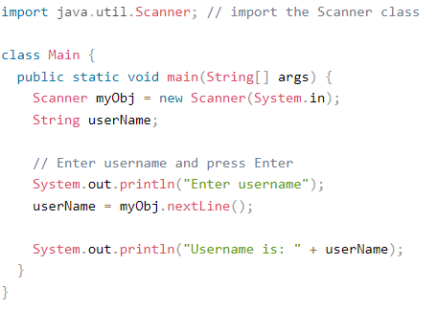
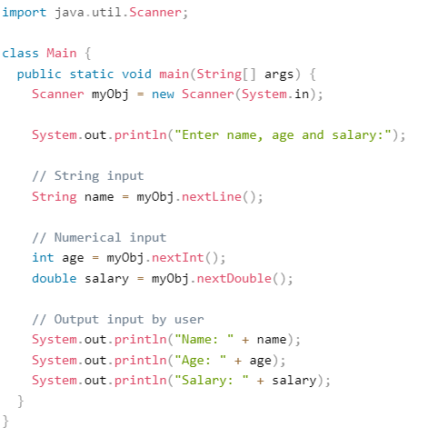
Java Scanner Class

Slide 6
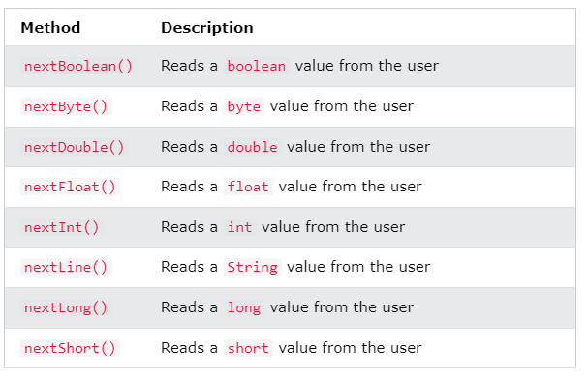
Java Scanner Class

Slide 7
Java Scanner Class for array input
import java.util.Scanner;
public class ArrayInputExample1 {
public static void main(String[] args) {
int n; Scanner sc=new Scanner(System.in);
System.out.print("Enter the number of elements you want to store: ");
n=sc.nextInt();
int[] array = new int[10];
System.out.println("Enter the elements of the array: ");
for(int i=0; i<n; i++)
{
//reading array elements from the user
array[i]=sc.nextInt();
}
System.out.println("Array elements are: ");
// accessing array elements using the for loop
for (int i=0; i<n; i++)
{
System.out.println(array[i]); } } }

Slide 8
Any Question
THANK YOU ☺

